Slide 1

Person
Have (Properties):
Do/Actions (Methods):
name
age
height
weight
date of birth
is married
speak
move
eat

Slide 2
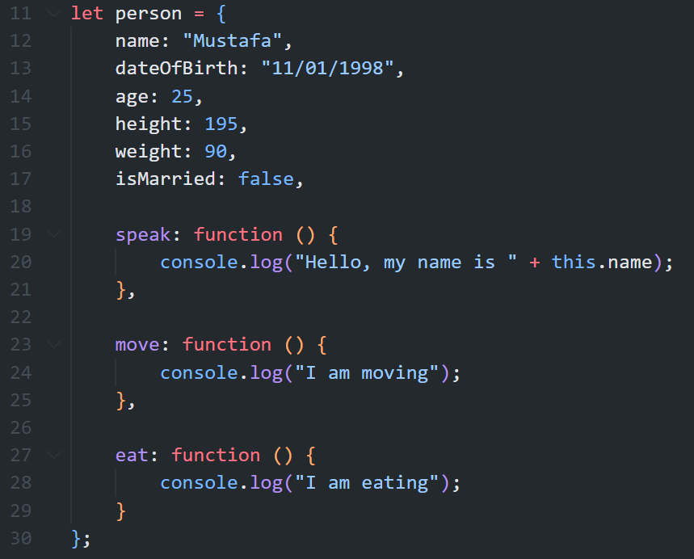

Slide 3
Memory
Memory
let num = 10;
10
{
title: “JS”,
pages: 150
}
let book1 = {
title: “JS”,
pages: 150
};
ref1

Slide 4
Memory
Memory
let num = 10;
10
{
title: “JS”,
pages: 150
}
let book1 = {
title: “JS”,
pages: 150
};
ref1
let book2 = book1;

Slide 5
Memory
Memory
let num = 10;
10
{
title: “JS”,
pages: 150
}
let book1 = {
title: “JS”,
pages: 150
};
ref1
let book2 = book1;

Slide 6
Exercise
let grades = {
math: 90,
science: 80,
english: 85
};
Create an object “grades” that represents a student’s grade in various courses. (key is the course name, and value is the grade) - Initially fill it with dummy data.
Create the following functions:
Add a course: Write a function that takes the course name and grade, and adds the new course to the grades object.
Find a grade: Write a function that takes a course name and returns the grade for that course.
Update a grade: Write a function that takes a course name and a new grade, and updates the grade for that course.
Remove a course: Write a function that takes a course name and delete it from the grades object.
List all courses with their grades: Write a function that lists all the courses in the grades object with their grades.
Calculate GPA: Write a function that calculates and returns the GPA.

